Slide 1

Face mask detection
Presented by:

Slide 2
Agenda
Introduction
Objective
Data Collection
Training of the Model
Evalution of the Model
Demo
Conclusion and Questions

Slide 3
Introduction
Reason for Choosing this project
Medical help
Covid-19 Situation
Automatic System
Tools used in this project
Keras
Pandas
Opencv
Dataset
data-flair.training
Testing and training parts
Streamlit

Slide 4

Objectives
Detect
Detect Face Mask of person
Use
Use custom model and train on dataset
Achieve
Achieve more than 90% accurate results
Create
In future create mobile app or web application

Slide 5
Tools used for the project
Python Language
Keras Module
OpenCV
Pandas
Jupyter-Notebook
Visual Code Studio

Slide 6
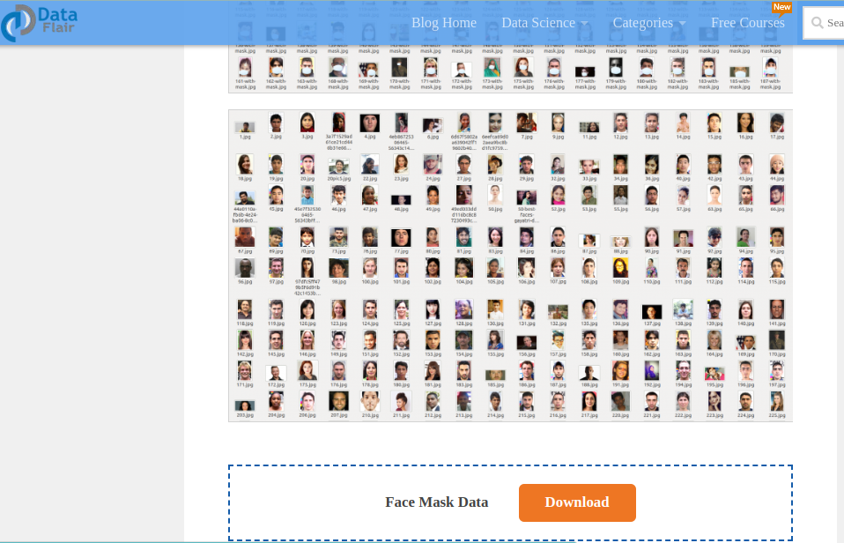
Data Collection

Slide 7
Preprocessing
Preprocessing is a crucial step in data analysis and machine learning. It involves transforming raw data into a format that is suitable for analysis or modeling.
The preprocessing techniques used on a dataset depend on the type of data and the analysis to be performed. Some common preprocessing techniques include:
Data cleaning: This involves removing or correcting any errors or inconsistencies in the data, such as missing values, duplicates, or outliers.
Data normalization: This involves scaling the data so that it falls within a specific range or distribution. Normalization can help to improve the accuracy and efficiency of machine learning algorithms.
Feature selection: This involves selecting the most relevant features or variables in the dataset that are likely to have the greatest impact on the outcome or analysis.
5.Feature engineering: This involves creating new features or variables based on the existing data that can improve the accuracy of the analysis or modeling.
6.Data transformation: This involves converting the data into a different format or representation that is more suitable for the analysis or modeling, such as converting text data into numerical vectors.
Overall, the goal of preprocessing is to prepare the data in a way that maximizes the accuracy and efficiency of the analysis or modeling.

Slide 8
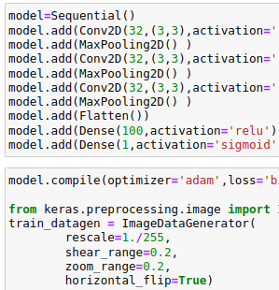
Model training
Training a model involves using a machine learning algorithm to learn patterns and relationships within preprocessed data.
During training, the algorithm iteratively adjusts its parameters based on the input data to minimize the difference between its predictions and the actual output.
Once trained, the model can be used to make predictions on new, unseen data. Its performance is evaluated using metrics such as accuracy, precision, recall, and F1-score, depending on the specific problem and evaluation criteria.

Slide 9
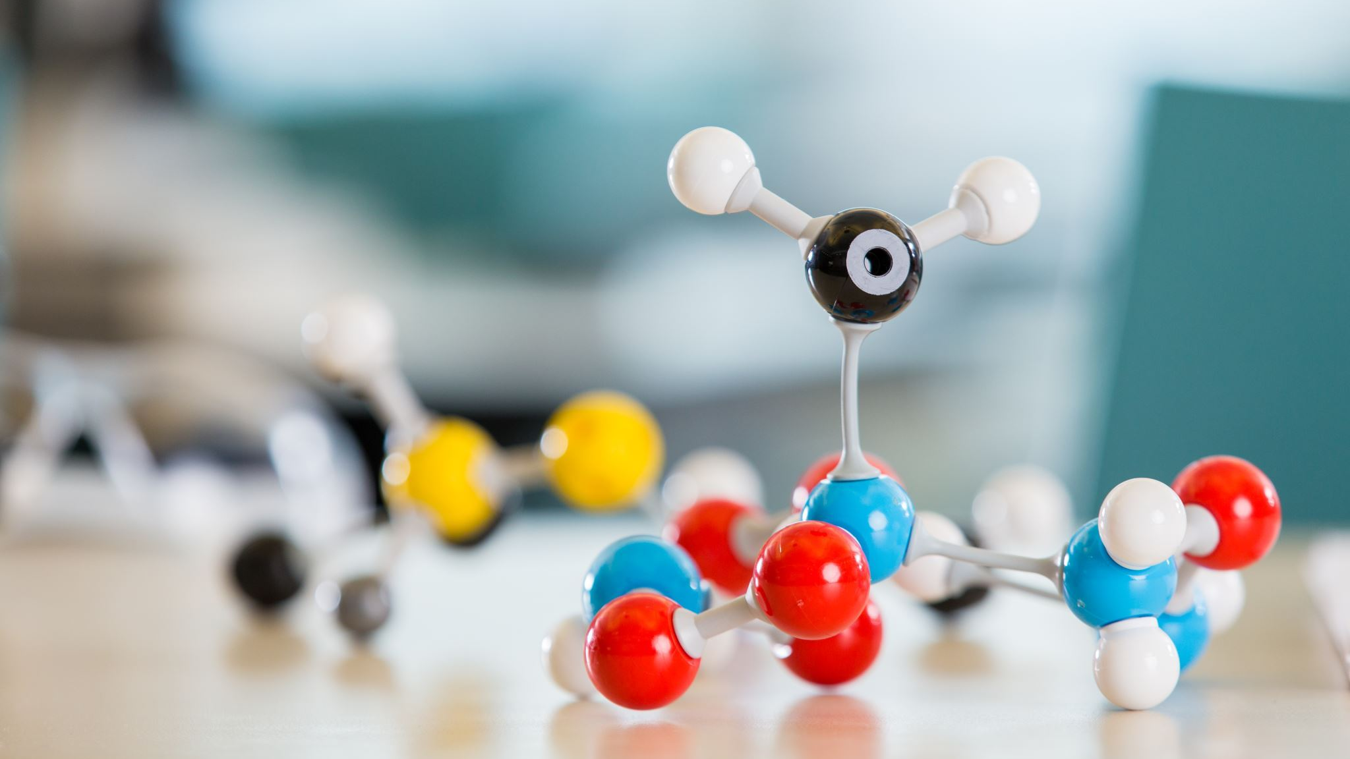
Evalution Of Model
Accuracy: 0.9794

Slide 10
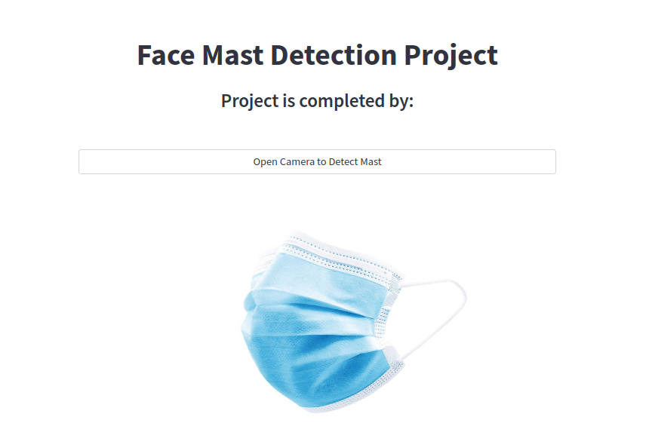
Web Application

Slide 11

Thank You
Questions

